Slide 1
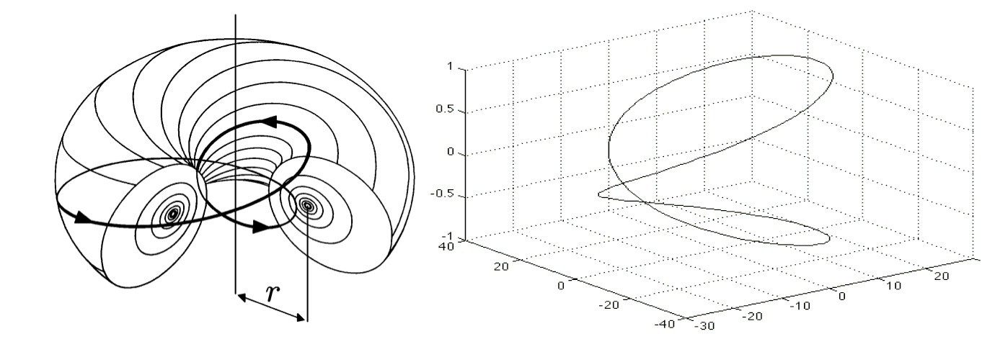
The screw nature of electromagnetism
by John Duffield
June 2025
Images by John Williamson and Martin van der Mark and by Qiu-Hong Hu

Slide 2
A note from history
See Maxwell’s 1861 On Physical Lines of Force and note this:
“a motion of translation along an axis cannot produce a rotation about that axis unless it meets with some special mechanism, like that of a screw”.
A screw? What did he mean by that? And why was he talking about molecular vortices? Here’s the screw again in Minkowski’s 1908 Space and Time:
“In the description of the field caused by the electron itself, then it will appear that the division of the field into electric and magnetic forces is a relative one with respect to the time-axis assumed; the two forces considered together can most vividly be described by a certain analogy to the force-screw in mechanics; the analogy is, however, imperfect”.
There’s the screw again. What did Minkowski mean? And what did he mean about the time axis? By the way, note that he referred to the field and the two forces. Remember that. It’s important.

Slide 3
What does Jackson say?
See page 558 of John Jackson’s Classical Electrodynamics. He says this:
“Transformation (11.149) shows that E and B have no independent existence”. He also says this:
"One should properly speak of the electromagnetic field F^{αβ} rather than E or B separately".
Unfortunately this in section 11, not at the start of the book. Sometimes I feel like Maxwell’s unification never happened.

Slide 4
What does Wikipedia say?
See the Wikipedia article on the electromagnetic field. It says this:
“Over time, it was realized that the electric and magnetic fields are better thought of as two parts of a greater whole - the electromagnetic field”.
See the Wikipedia article on Jefimenko’s equations. It quotes Oleg Jefimenko saying this:
“Neither Maxwell’s equations nor their solutions indicate an existence of causal links between electric and magnetic fields. Therefore, we must conclude that an electromagnetic field is a dual entity”.
When I first referred to this page, it also said this:
“The second feature is that the expression for E does not depend upon B and vice versa. Hence, it is impossible for E and B fields to be "creating" each other”.
This means what they say about electromagnetic waves not needing a medium is wrong. The E wave does not create an orthogonal B wave which creates the E wave and so on. The wave concerned is the electromagnetic wave. There’s only one wave there.

Slide 5
The electromagnetic wave is one wave, not two
See the Wikipedia electromagnetic radiation article and note this:
“the curl operator on one side of these equations results in first-order spatial derivatives of the wave solution, while the time-derivative on the other side of the equations, which gives the other field, is first order in time”.
This is talking about one wave and two derivatives. The spatial derivative of the wave solution yields E, the time derivative yields B. How can we understand this in a simple way? Using a canoe analogy:
Imagine you’re in a canoe far out to sea. Imagine an oceanic swell wave comes towards you. Let’s say it’s a 10m high sinusoidal hump of water without a trough. As the wave approaches, your canoe tilts upward. The degree of tilt denotes E, whilst the rate of change of tilt denotes B. These are at a maximum when you’re halfway up the wave. When you’re momentarily at the top of the wave, your canoe is horizontal and has momentarily stopped tilting, so E and B are zero. Then as you go down the other side, the situation is reversed.

Slide 6
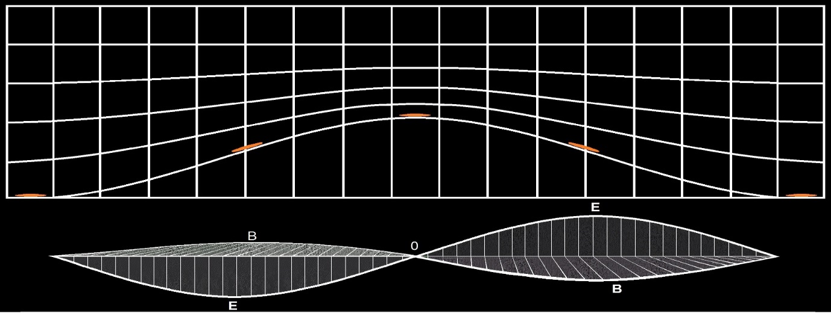
Depicting the canoe analogy
I can depict the electromagnetic wave as per the upper portion of the image below, also showing the space and time derivatives in the lower portion:
The lower portion is the typical depiction of orthogonal E and B waves, which is wrong. Because there’s only one wave there. The electromagnetic wave.

Slide 7
How do we make a standing electromagnetic field?
An electromagnetic wave is a transient field variation. It is not a standing electromagnetic field. So how do we make one? We employ pair production. See Gamma rays create matter just by plowing into laser light. And what happens in pair production? Let’s ask Schrödinger:
Screenshot from Erwin Schrodinger’s 1926 Quantisation as a problem of proper values Part II
We make a standing electromagnetic field by making an electromagnetic wave move in a small closed path whose dimensions are of the order of the wavelength. However it isn’t really standing. It might look motionless, but it isn’t, because it’s really an electromagnetic wave going round and round at the speed of light.

Slide 8
What does the electromagnetic field look like?
Oddly enough there are no depictions of the electromagnetic field. There are depictions of the “electric field” and the “magnetic field”, but not the electromagnetic field. There are however depictions of the gravitomagnetic field:
Gravity-probe B image by James Overduin, Pancho Eekels and Bob Kahn
See the NASA gravity-probe B article which talks of frame dragging and a space-time vortex. Or the Space article which says “space is twisted”. Gravitomagnetism was developed by Oliver Heaviside as A gravitational and electromagnetic analogy in 1893.

Slide 9
Maxwell tried to depict it
In 1871 Maxwell wrote a paper entitled Remarks on the Mathematical Classification of Physical Quantities. He referred to Descartes, to Helmholtz and “his great paper on vortex motion”. He also referred to Thomson and Tait, and to Ampère. Maxwell said this:
“According to Ampère and all his followers, however, electric currents are regarded as a species of translation, and magnetic force as depending on rotation. I am constrained to agree with this view, because the electric current is associated with electrolysis, and other undoubted instances of translation, while magnetism is associated with the rotation of the plane of polarization of light, which, as Thomson has shown, involves actual motion of rotation”.
This is the paper where Maxwell drew this picture combining translational convergence and rotational curl:

Slide 10
Can we improve on Maxwell’s depiction?
I expect you have all seen the typical depictions of the radial electric field lines and the concentric magnetic field lines, such as those on 1) Andrew Duffy’s PY106 course and 2) Geek on Wikipedia. We can combine them like Maxwell did, but better:
The depiction of the electromagnetic field on the right resembles the typical depiction of a vector field. Note thought that this is only a two-dimensional depiction. A depiction in three dimensions is more difficult.

Slide 11
Here’s another depiction
Here’s another two-dimensional depiction which uses the picture of the electromagnetic wave on slide 6.
The thing on the left is a 511keV photon, the thing on the right is an electron. Think of the electron as an optical vortex, the electromagnetic equivalent of a hurricane. But note that the eye of the storm is not the storm. The electron is not some billiard-ball thing that has a field, the electron’s field is what it is.
Maxwell would have called it a A worble embracing itself. Peter Guthrie Tait would have called it a trivial knot. Maxwell talked of molecular vortices, Tait and Thomson talked of the vortex_atom, and they were all ahead of their time.

Slide 12
Here’s a further depiction, do try this at home:
Cut a long thin flat-bottomed sinusoidal strip out of say Christmas wrapping paper, with different colours on each side. Bring the two ends of your flat-bottomed sinusoidal paper strip together. Twist one end by 180°, and then slide the two ends past one another, and keep doing this until the strip is wrapped around twice in a 720° double loop. Then apply Sellotape:
Strip and Mobius images by me, GNUFDL spinor image by Slawkb, see Wikipedia
You end up with something resembling a Möbius strip. It looks like one loop, but it’s really two. It also resembles the typical depiction of a spinor, which is said to be “essential to describe the intrinsic angular momentum, or ‘spin’, of the electron”.
Take a look at your Möbius strip. The minima and maxima of the original flat-bottomed sinusoidal strip combine along with all points between to give you something that’s the same width all round. In similar vein the electromagnetic field variation is no longer displaying any sinusoidal field variation. This is why the electron has an all-round electromagnetic field, to which we apply the label charge. It means charge isn’t fundamental, it’s topological. PS: mass is just resistance to change-in-motion for a wave in a closed path.

Slide 13
A note on displacement current
You don’t need a point charge going round and round to cause the electron magnetic moment. Take a look at the Wikipedia article on displacement_current and note this:
“Displacement current density has the same units as electric current density, and it is a source of the magnetic field just as actual current is. However it is not an electric current of moving charges, but a time-varying electric field”.
See the 2010 physicsworld article taming light at the nanoscale. It’s about displacement current in optical circuits. The point to note is that light itself is a time-varying electric field.
PS: The electron g-factor is circa 2 because the light goes round twice.
PPS: Take a look at the proton g-factor and the next knot in the knot table.

Slide 14
The photon is not a flat sinusoidal strip, the electron is not a ring
The photon is not a flat sinusoidal strip. It’s a wave in three-dimensional space. Likewise the electron is not a Möbius strip. To depict it better we have to inflate the Möbius strip like it’s a flattened inner tube. We inflate it to a torus, then we keep on inflating past the horn-torus stage to the spindle-sphere stage. Only then does it start to resemble an S-orbital electron:
Torus animations by Adrian Rossiter, S-orbital image from the 2010 Encyclopaedia Britannica
However the above is not showing the outer portion of the electron, it’s only showing the electromagnetic equivalent of the eye of the storm.

Slide 15
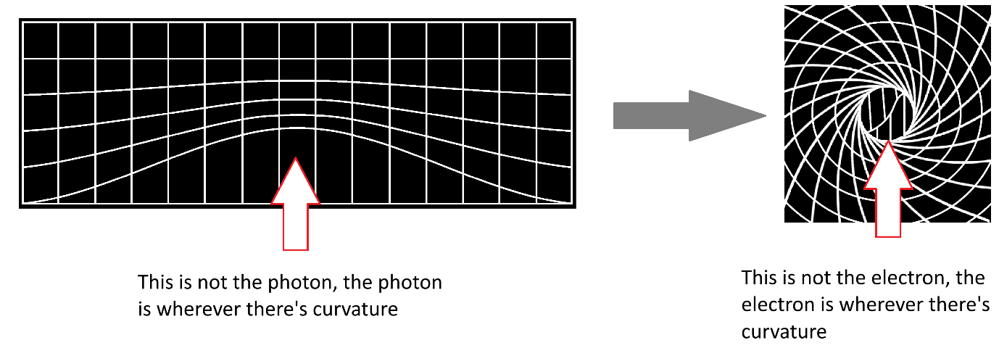
Depictions can be difficult
It can be difficult to visualize these things, but that’s no reason to shut up and calculate. Here’s a better depiction, but again, it’s only two-dimensional:

Slide 16
A field is a state of space
See what Einstein said: space is primary, and a field is a state of space. When it came to electromagnetic and gravitational fields, he said this:
“It can, however, scarcely be imagined that empty space has conditions or states of two essentially different kinds, and it is natural to suspect that this only appears to be so because the structure of the physical continuum is not completely described by the Riemannian metric”.
He also said a gravitational field is a place where space is:
“neither homogeneous nor isotropic”.
He didn’t say it was a place where space is curved. See the Baez preliminaries article:
“Similarly, in general relativity gravity is not really a ‘force’, but just a manifestation of the curvature of spacetime. Note: not the curvature of space, but of spacetime. The distinction is crucial”.

Slide 17
So what’s the state of space for an electromagnetic field?
Maxwell said this: “light consists of transverse undulations”. Don’t overthink it.
When an ocean wave propagates through the sea, the sea waves. When a seismic wave propagates through the ground, the ground waves. And when an electromagnetic wave propagates through space, then surely space waves. There are no waves where something doesn’t wave. And where that something is waving, it is curved. So something else passing through that something will follow a curved path. If that something else is light, its path will curve. When light moves through space where light is, light curves. Then when light moves through itself just right, its path can curve into a closed path. Not because of some magical force. But because like Percy Hammond said:
“the field describes the curvature that characterizes the electromagnetic interaction”.
So what’s the state of space for an electromagnetic field?
Curved.
Electromagnetism is the strong curvature regime, not black holes.

Slide 18
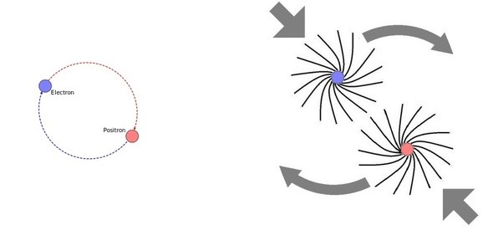
How do charged particles move?
Opposite charged particles like the electron and the positron move around one another and towards one another. That’s because each is a “dynamical spinor”, and because electromagnetic field interactions result in linear electric force and rotational magnetic force.
CCASA positronium image by Manticorp/Rubber duck, see Wikipedia, spinor image drawn by me
Note that it’s one field which results in two forces, not two different fields. The motion is vorticial: counter-rotating vortices attract, co-rotating vortices repel. The motion does not occur because a point particle is situated in a field of force. It occurs because the particle spin is affected by its local state of space.

Slide 19
Another historical note:
Born and Infeld’s 1935 paper On the quantization of the new field theory II is interesting. On page 12 they said this:
“the inner angular momentum plays evidently a similar role to the spin in the usual theory of the electron. But it has some great advantages: it is an integral of the motion and has a real physical meaning as a property of the electromagnetic field, whereas the spin is defined as an angular momentum of an extensionless point, a rather mystical assumption”.
On page 17 they said this:
“we think that the value of Dirac’s theory lies more in mathematical advantages than in its physical significance. It is well known that other systems with spin ½ do not obey Dirac’s laws; even the simplest one, the proton, has properties contradicting the consequences of Dirac’s equation”.
They also said this:
“the rest-mass occurring in our theory is not, as in Dirac’s, an absolute constant of the system but the total internal energy, depending on rotation and internal motion of the parts of the system. An external field will influence not only the translational motion, but also these internal motions”.

Slide 20
So what’s an electric field, and what’s a magnetic field?
I think it’s simpler than you think:
An electric field is where we contrive our charged particles such that the rotational forces cancel but the linear forces do not.
A magnetic field is where we contrive our charged particles such that the linear forces cancel but the rotational forces do not.

Slide 21
Why does motion transform an electric field into a magnetic field?
Again I think it’s simpler than you think:
Because the frame-dragged curved space of electromagnetism is like twist and turn.
So you can think of an electromagnetic field as a “twist” field. A place where space is curved, this curvature typically diminishing from a central point. Note this:
If you move relative to a twist field you might say it’s a turn field.
Or a rotor field if you prefer. The European term for curl is rot, which is short for rotor. Also note this:
If you moved relative to a turn field, you might say it’s a twist field.
It’s nothing to do with length contraction. That’s a myth invented by Edward Purcell in section 5.9 of his 1963 book Electricity and Magnetism. It is still promoted, with unfounded claims that the wire acquires a net negative charge. It does not. Note that a photon is not subject to length contraction. I recommend that you exclude length contraction from electron models.

Slide 22
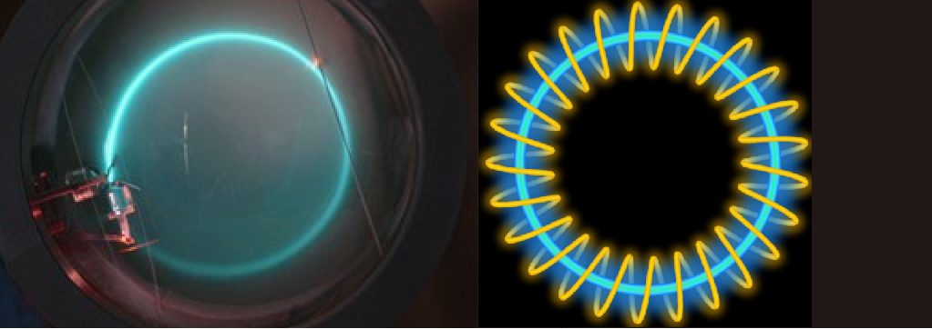
Why does an electron go round in circles in a uniform magnetic field?
Because of Larmor precession: the spin angular momentum of an electron is a real rotation as evidenced by the Einstein-de Haas effect. It “precesses counter-clockwise about the direction of the magnetic field”. It is not unlike the gyroscopic precession of a boomerang. A positron goes around and around clockwise like a left-handed boomerang. You can emulate it with a slinky spring:
Teltron tube image from demoweb UCSC Slinky+neon image by Ofnuts

Slide 23
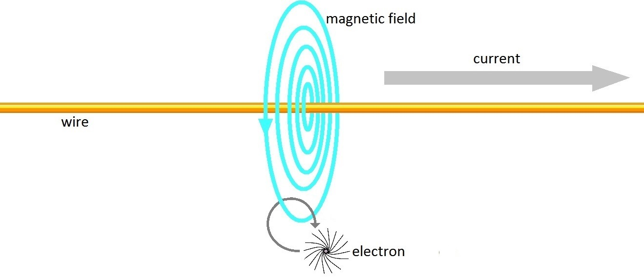
How does a magnet work?
In a non-uniform magnetic field, the electron goes round in circles, but they aren’t perfect circles:

Slide 24
How does a magnet work? 2
Hence there’s a Grad-B drift, which results in a linear motion:
It’s the same for the iron core of a solenoid. The magnetic field is non-uniform at the mouth of the solenoid, so there’s a linear motion into the solenoid. However once the core is inside the solenoid the magnetic field is uniform, so there is no more linear motion.

Slide 25
A further historical note:
In 1820 Ampère invented the word solenoid, saying a solenoid had a magnetic field like a bar magnet. He said this:
“if the spirals acted like magnets, it was because magnets owe their magnetism to electric currents in planes perpendicular to their axes”.
See Ampère’s researches in the science of electrodynamics. That’s where Ampère said this:
“Is it not evident, then, to all how memorable would that discovery be that would rigorously establish the fact that to magnetize a needle is to excite, to put in motion around each molecule of the steel, a small, circular, electrical vortex?”
See chapter1 of the 1996 book Geometry of electromagnetic systems by Daniel Baldomir and Percy Hammond. They give a history of electromagnetism, starting with William Gilbert who wrote a book called De Magnete in 1600. They tell us how according to Gilbert:
“the magnetic force was not a simple attraction but a ‘coition’ which involved rotation”.

Slide 26
Faraday’s Law
To wrap up, the screw nature of electromagnetism is why we have Faraday’s law:
∇ × E = − ∂B/∂t
Not because changing one field creates the other, or because one circulates round the other. The equals sign is an “is”. The curl of E is the time rate of change of B. Because they’re two aspects of the same thing: the electromagnetic field.

Slide 27
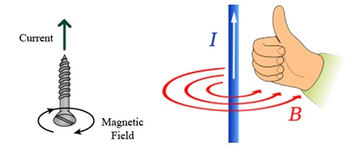
The right hand rule applies to screw threads too
The right hand rule applies to the current in the wire, and to screw threads too:
Screw image by Kiran Daware, see electrical easy, GNUFDL right-hand rule image by Jfmelero, see Wikipedia
This is why it’s the screw nature of electromagnetism!

Slide 28
Further reading
See the following “physics detective” articles which contain details and references. Apologies for any links which no longer work:
What is a photon? The photon
The hole in the heart of quantum electrodynamics
How pair production works
The electron
The positron
The screw nature of electromagnetism
How a magnet works
Why magnetic monopoles do not exist
What charge is
The mystery of mass is a myth
What energy is
The TOE that Maxwell missed
A worble embracing itself
The theory of everything
The Standard Model of particle physics is wrong on multiple counts
Gerard ‘t Hooft says quantum mechanics is nonsense
End of presentation

