Slide 1
Quantum entanglement does not exist
The experimental results merely demonstrate Malus’s law

Slide 2
History:
1935: Einstein, Podolsky, and Rosen said quantum mechanics must be incomplete because it predicts a system in two different states at the same time. Bohr gave a dismissive reply saying spooky action at a distance could occur. Then Schrödinger came up with a paper where he introduced the word “entanglement”, a paper where he used his cat to show how ridiculous the two-state situation was, and a paper saying he found spooky action at a distance to be repugnant. He also compared it to Voodoo magic, where a savage “believes that he can harm his enemy by piercing the enemy’s image with a needle”.
1952: Bohm came up with two hidden variables papers which retained the spooky action at a distance. He also came up with a proposed EPRB experiment, which was the subject of a paper in 1957. This is where he said the only practicable test was via “the polarization properties of correlated photons”.
1964: Bell came up with papers On the Problem of Hidden Variables in Quantum Mechanics and On the Einstein Podolsky Rosen Paradox. Bell said the issue was resolved in the way Einstein would have liked least, and gave a mathematical “proof” which is usually called Bell's theorem.
1969: Clauser et al wrote the CHSH paper on a Proposed Experiment to Test Local Hidden-Variable Theories. Then in 1972 came Clauser and Freedman’s Experimental Test of Local Hidden-Variable Theories. Then in 1981 came Experimental Tests of Realistic Local Theories via Bell’s Theorem by Aspect et al, followed by two further papers in 1982. Then in 1998 came Violation of Bell’s inequality under strict Einstein locality conditions by Zeilinger et al. All these Bell test experiments used photons and polarizing filters. They featured ever-increasing complexity to cater for so-called loopholes, and are said to have “convinced the physics community in general that local realism is untenable”.
2022: the physics Nobel Prize was awarded to Clauser, Aspect, and Zeilinger “for experiments with entangled photons, establishing the violation of Bell inequalities and pioneering quantum information science”.

Slide 3
Bell’s sophistry
However Bell’s 1964 paper On the Einstein Podolsky Rosen Paradox did not address the physics of spin ½. Instead Bell gave a rambling obscure mathematical “proof” which culminated in the grandiose claim that “the signal involved must propagate instantaneously”.
Introduction Bell made the grand claim that non-locality is characteristic of any theory which “reproduces exactly the quantum mechanical predictions”.
Section II Bell talked about an entangled pair of spin ½ particles. He defined terms $\vec{σ}$₁ ∙ $\vec{a}$ and $\vec{σ}$₂ ∙ $\vec{b}$ to describe a ±1 Stern-Gerlach measurement on particle 1 at magnet angle a, and a similar measurement on particle 2 at magnet angle b. His equation 2 said the expectation value for such measurements was P($\vec{a}$, $\vec{b}$) = ∫ d λ p(λ) A($\vec{a}$, λ) B($\vec{b}$, λ), where λ denoted a set, A being a result of measuring particle 1 and B being a result of measuring particle 2. Bell also said a hidden-variable expectation value should equal the quantum-mechanical singlet state expectation value < $\vec{σ}$₁ ∙ $\vec{a}$ $\vec{σ}$₂ ∙ $\vec{b}$ > = – $\vec{a}$ ∙ $\vec{b}$ , but that “it will be shown that this is not possible”.
Section III Bell said < $\vec{σ}$ ∙ $\vec{a}$ > = cos θ and referred to a hidden variable in the form of “a unit vector λ, with a uniform probability distribution”. However Stern-Gerlach magnets don’t just measure spin, they also alter it. Bell knew this. See figure 6 of Bertlmann’s Socks And The Nature Of Reality.
Section IV: Bell gave equation 13 A($\vec{a}$, λ) = – B($\vec{a}$, λ), which means the A and B sets of measurements will be opposite if the magnet angles are the same. Then in his equation 14, he treated a set of measurements as a simple number, and said the expectation value P($\vec{a}$, $\vec{b}$) = – ∫ d λ p(λ) A($\vec{a}$, λ) A($\vec{b}$, λ). That’s saying you can get the same results using only the A measurements, because they’re the opposite of the B measurements. That introduces an unwarranted linear relationship. Then Bell introduced another measurement at angle c, and came up with equation 15, which is Bell’s inequality:
1 + P($\vec{b}$, $\vec{c}$) ≥ |P($\vec{a}$, $\vec{b}$) – P($\vec{a}$, $\vec{c}$)|

Slide 4
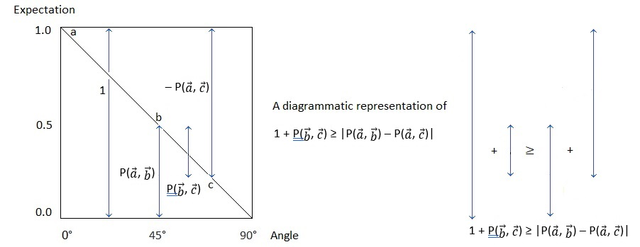
A diagrammatic representation of Bell’s inequality
One plus the bc term is greater than or equal to the ab term plus the minus ac term. Note that Bell knew about cos θ but his inequality deliberately employs a linear relationship. It is akin to the way probabilities add up to 1. It results in the claim that the “classical prediction” describes a straight line.

Slide 5
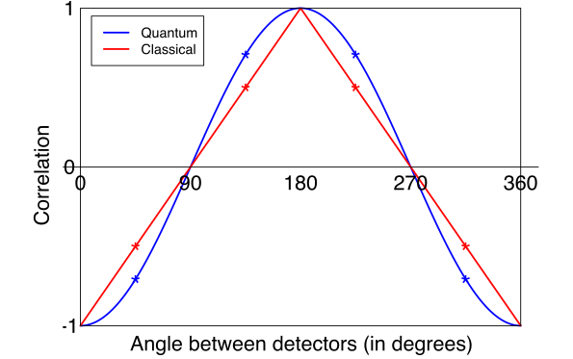
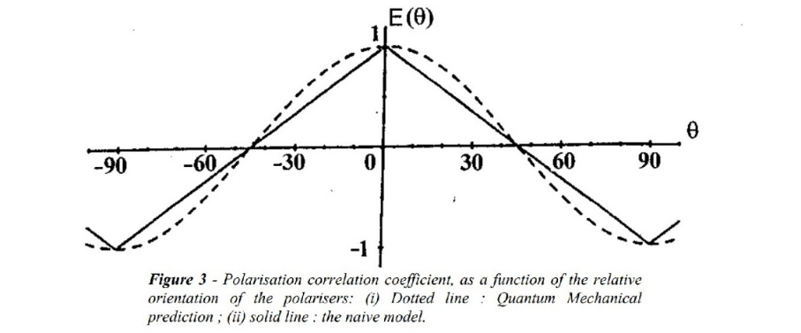
Bell’s inequality is said to yield a straight-line prediction
Bell’s inequality is usually illustrated with a picture like the one below by Gill, with a straight-line classical prediction, and a curved quantum-mechanical prediction:
It says the classical prediction for the correlation at 45° is -0.5, whilst the quantum mechanical prediction is -0.707. See the Stanford article where Abner Shimony and others say this: “In Bell’s toy model, correlations fall off linearly with the angle between the device axes”. You can see a similar depiction in Alain Aspect’s 2004 paper Bell's Theorem: The Naive View of an Experimentalist:

Slide 6
Note this from the Wikipedia Bell's theorem article:
In his paper Aspect mentioned Malus’s Law, which is of crucial interest. Note this from the Wikipedia Bell's theorem article:
It says vectors a and b are orthogonal, vector c is at a 45° angle to both of them, and P is a correlation. When you combine a and b, the result is zero. That’s cos 90°. Combine a and c, or b and c, and the result is –√2/2, which is –0.707. That’s cos 45°. The claim is that 0.707 is not less than 1 – 0.707 = 0.293, therefore “there is no local hidden variable model that can reproduce the predictions of quantum mechanics”. However polarizing filters can.

Slide 7
Polarizing filters
Take two polarizing filters and place them in a light beam, one orthogonal to the other. No light gets through. Add a third filter between the first two at a 45° angle. Now some of the light gets through:
The third polarizing filter is sometimes described as mysterious, but Darel Rex Finley explained it well in his 2004 article. He described how a horizontal polarizing filter doesn’t just let through a horizontally polarized light wave. It lets through the horizontal component of a light wave polarized at some angle, also rotating it so that it ends up horizontal. Here are Finley’s depictions:

Slide 8
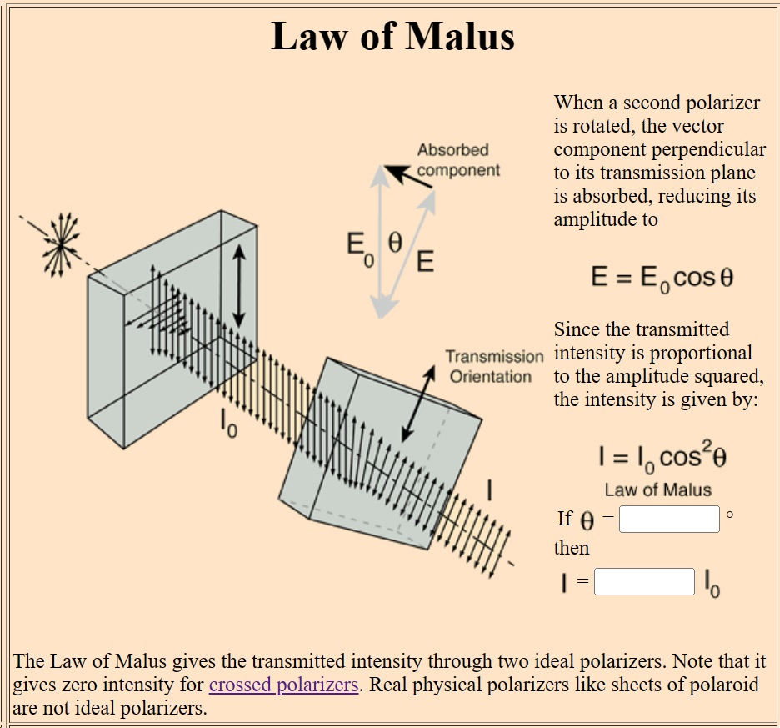
Malus’s Law
There’s a cosine relation here. Cos 0° = 1, cos 22.5°= 0.923, cos 45° = 0.707, cos 67.5° = 0.382, cos 90° = 0. It’s related to Malus’s law, which gives the intensity of the transmitted light as I = I₀ cos² θ.
The square is there because “the transmitted intensity is proportional to the amplitude squared”. Note that we demonstrate Malus’s law with light passing through two successive polarizers, and we do a Bell test with light passing through two opposite polarizers. In both cases a cosine relation applies, not a linear relationship. In an entanglement experiment we emit a random assortment of photon pairs towards polarizing filters A and B. If the polarizing filters have the same alignment, if you detect a photon at A you will detect a photon at B. If you rotate filter B round by 90° and repeat, then if you detect a photon at A you will not detect a photon at B. There’s a sliding scale between the two extremes, but it is not linear. It describes a cosine-like curve because that’s how polarizing filters work.

Slide 9
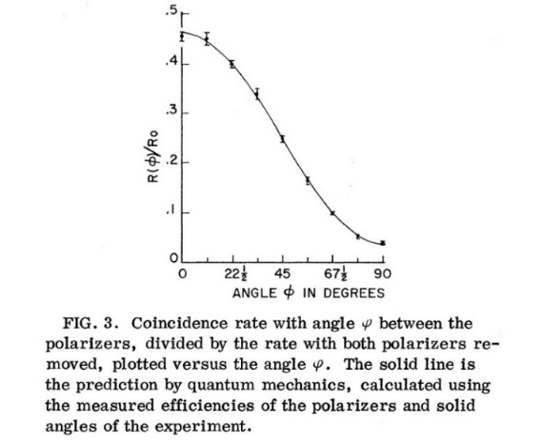
Clauser and Freedman’s result does not demonstrate quantum entanglement
This means Clauser and Freedman’s result does not demonstrate quantum entanglement. It merely demonstrates Malus’s Law. Polarizer A alters the polarization of photon A. It doesn’t alter the polarization of photon B.
Clauser and Freedman’s photons were not even entangled. The wavelengths were 581 nanometres and 406 nanometres. They weren’t the same wavelength because the photons were not produced at the same time. They were “calcium cascade” photons. Clauser and Freedman referred to an intermediate state lifetime of 5 nanoseconds. The photons were produced 5 nanoseconds apart. A photon travels 1.5 metres in 5 nanoseconds. By the time the second photon was emitted, the first photon was through the polarizer. Those photons weren’t entangled at all. Aspect used the same calcium cascade. So his photons weren’t entangled either. That’s why you can do a Bell-type Polarization Experiment With Pairs Of Uncorrelated Optical Photons, and get the same result. This is why Al Kracklauer was talking about Malus’s law twenty years ago. And why Dean L Mamas wrote a no-nonsense “realist” paper called Bell tests explained by classical optics without quantum entanglement. It’s brief and to the point, saying this: “The observed cosine dependence in the data is commonly attributed to quantum mechanics; however, the cosine behavior can be attributed simply to the geometry of classical optics with no need for quantum mechanics”. Zeilinger’s experiments do not demonstrate entanglement either. All this means that quantum entanglement is scientific fraud, and quantum computing will never deliver anything useful.

Slide 10
Details and other references
https://physicsdetective.com/quantum-entanglement-i/
https://physicsdetective.com/quantum-entanglement-ii/
https://physicsdetective.com/quantum-entanglement-is-scientific-fraud/
https://physicsdetective.com/bertlmanns-socks-and-the-nature-of-reality/
https://physicsdetective.com/there-is-no-quantum-entanglement/
A Comparison of Bell’s Theorem and Malus’s Law: Action-at-a-Distance is not Required in Order to Explain Results of Bell’s Theorem Experiments by Austin J Fearnley.
Disentangling entanglement by Antony R Crofts, Entanglement: A Contrarian View by A F Kracklauer, Simple experimental setup for producing polarization-entangled photons by W Rojpattanakul et al.
Polarization Correlation of Entangled Photons Derived Without Using Non-local Interactions by Kurt Jung, who said “In consequence Bell's inequalities are irrelevant”.
Analyzer Output Correlations Compared for Entangled or Non-entangled Photons by Gary Gordon, who said “Our predicted results for this non-entangled photon case are an exact match to those reported in the literature for the analysis and experimental outcomes for the entangled photon case”.
A New Model for Linear Polarizing Filter by Herb Savage, who said “This new single-photon model for a linear polarizing filter shows the same apparent violation of Bell's theorem as current loophole-free experiments”.
Fatal_Flaws_in_Bell’s_Inequality_Analyses_Omitting_Malus_Law_and_Wave_Physics_Born_Rule by Arthur S Dixon. who talked about the conscious or negligent omission of Malus’ law in the furtherance of scientific fame and fortune. He refers to a paper called Bell's Theorem and Einstein's ‘Spooky Actions’ from a Simple Thought Experiment: The Physics Teacher by Fred Kuttner and Bruce Rosenblum who give a reference 11 to Malus’s law on page 128.
Rotational Invariance, Phase Relationships and the Quantum Entanglement Illusion by Caroline H Thompson, along with The tangled methods of quantum entanglement experiments . She said “They appear to be rejecting papers that endanger the accepted dogma”.
Classical Interpretation of EPR- Bell Test Photon Correlation Experiments by Thomas Smid.
Experimental Counterexample to Bell’s Locality Criterion by Ghenadie N. Mardari who said “If polarization measurements are interpreted as transformations, then there is no mystery to explain”, Visualization of quantum entanglement by Stefan Heusler.

